Slide 1
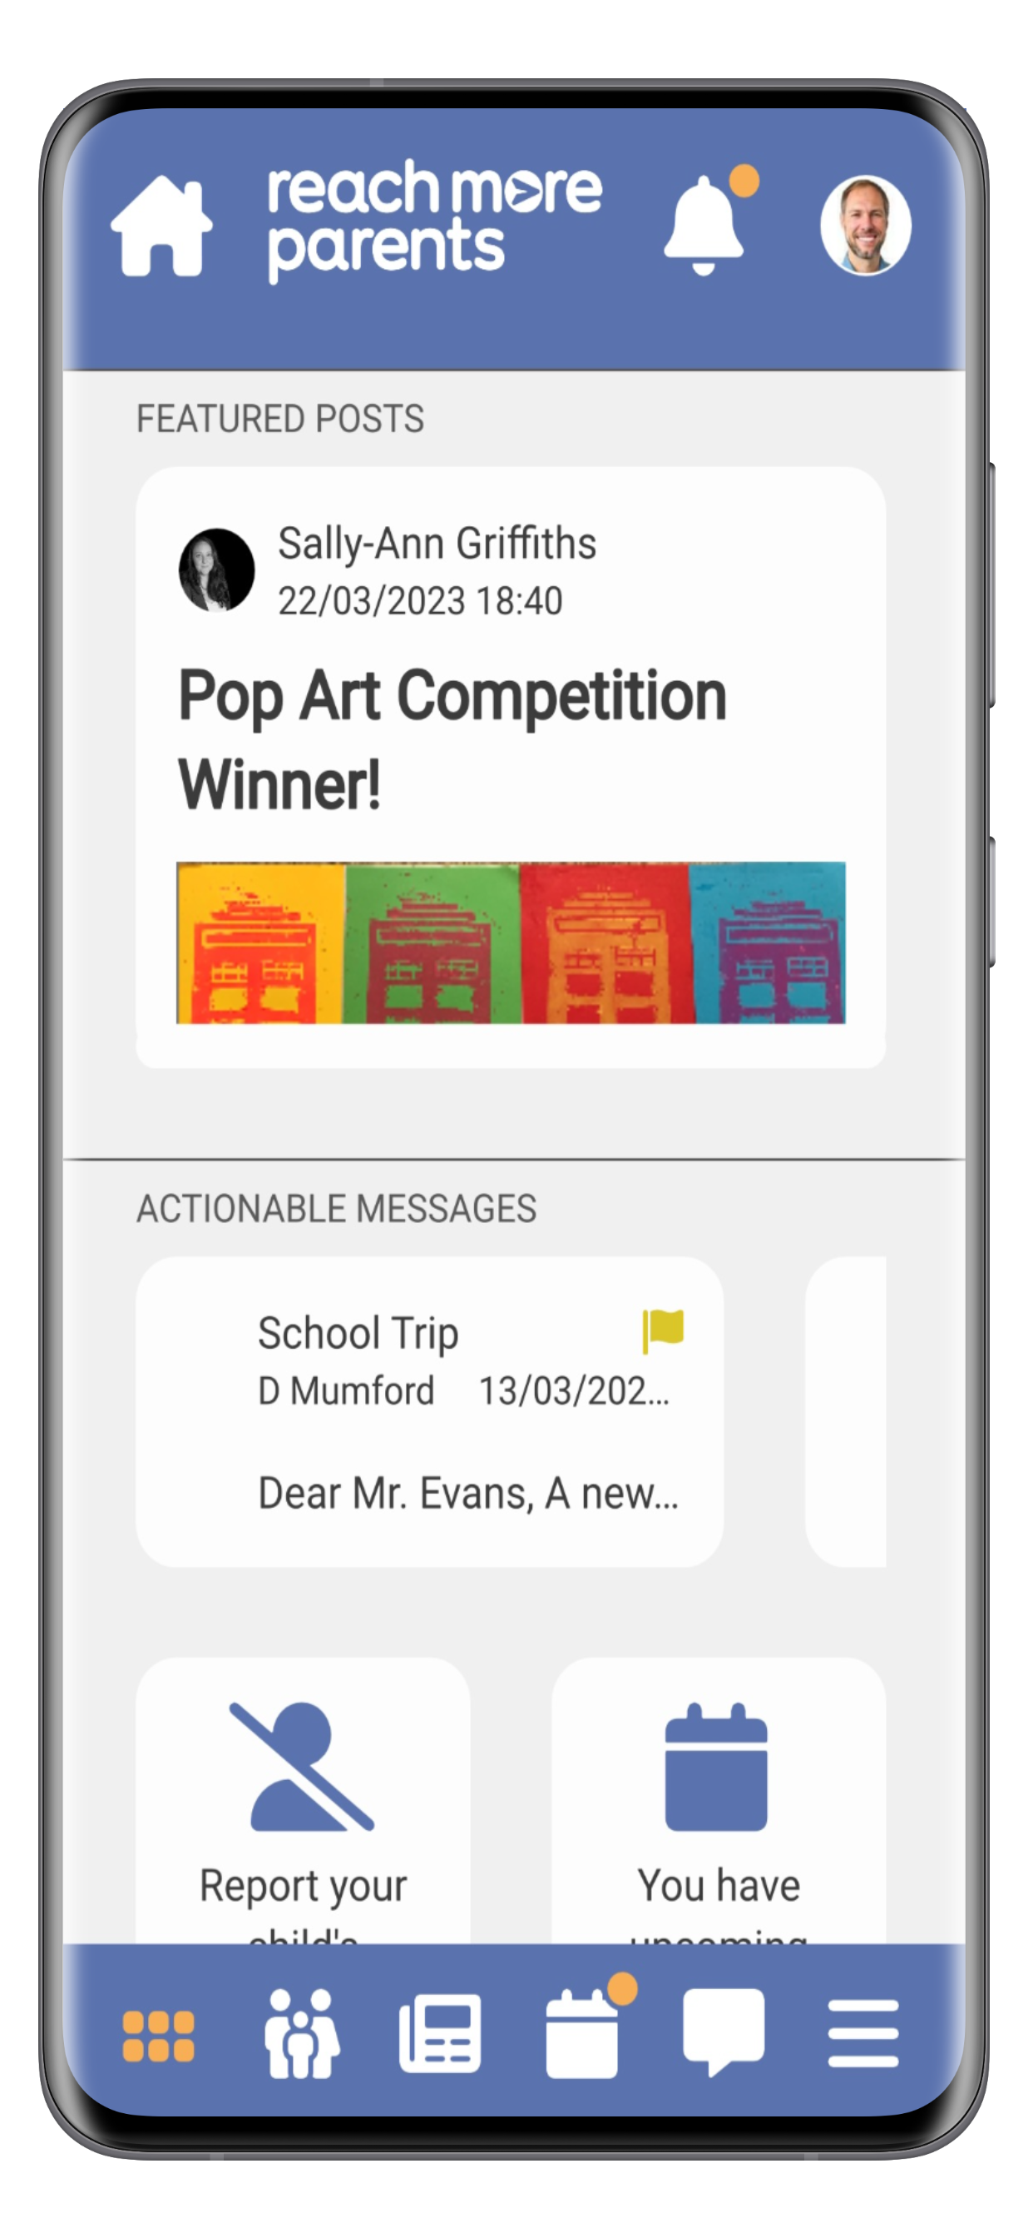



Add your school logo here

Slide 2
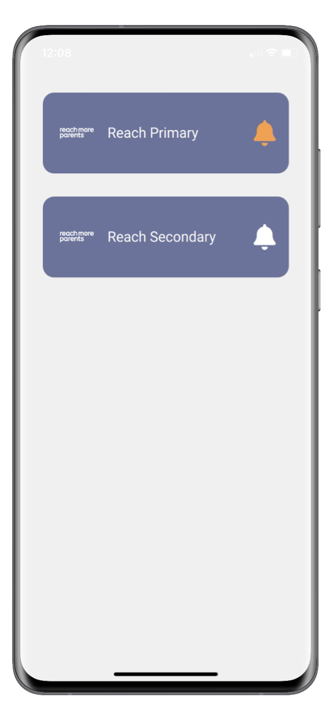

Navigation
School Selector
Parents can easily select between the different schools their children may be attending.
Upon opening the app, parents simply select which school they want to view information from.
Parents with children at only one school will bypass this and automatically see their own school.

Slide 3
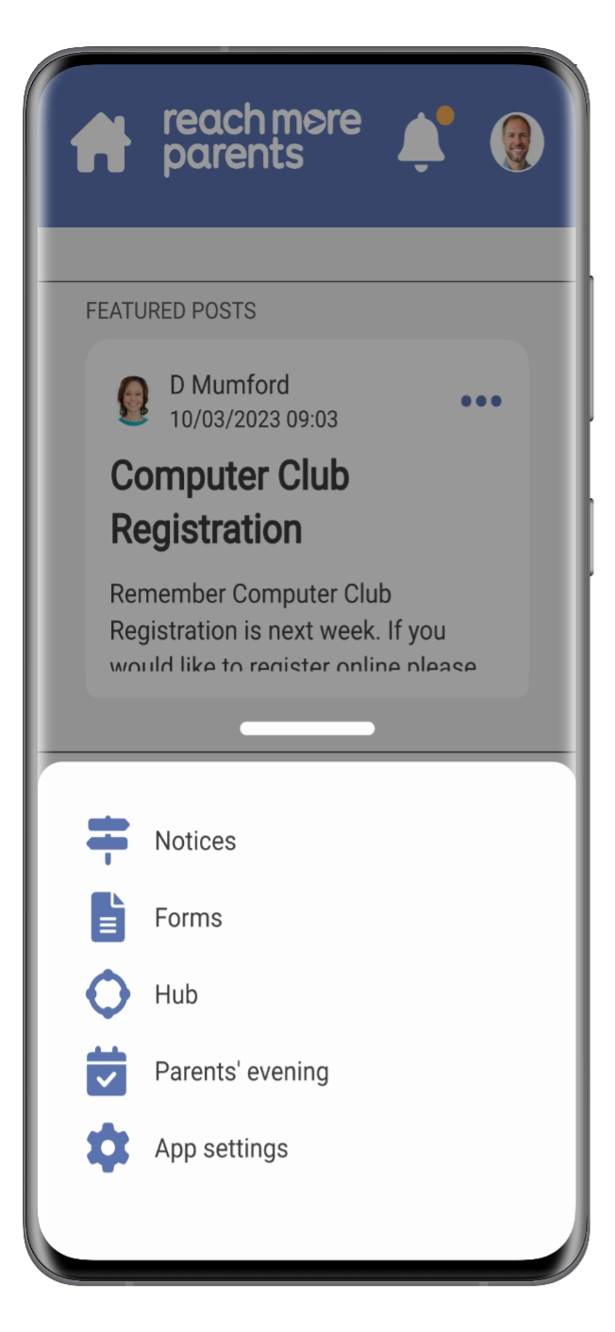
Navigation
Bottom Navigation Bar
The bottom navigation bar contains the most common features used by parents.
There is also an additional hamburger navigation menu where less common features can be found.

Slide 4


Navigation
Icons
Dashboard
Quick Access to Important Information
Parent Section
Information About Your Child
News Feed
News and Updates from School
Calendar
School events
Messages
Communications from School
Menu
Access to Additional Features

Slide 5
Navigation
Dashboard
For busy parents who want to see important information they need to act on, our dashboard highlights these.
It will display, for example, featured posts (pinned posts), upcoming events and content requiring a parental response, such as consent forms.

Slide 6
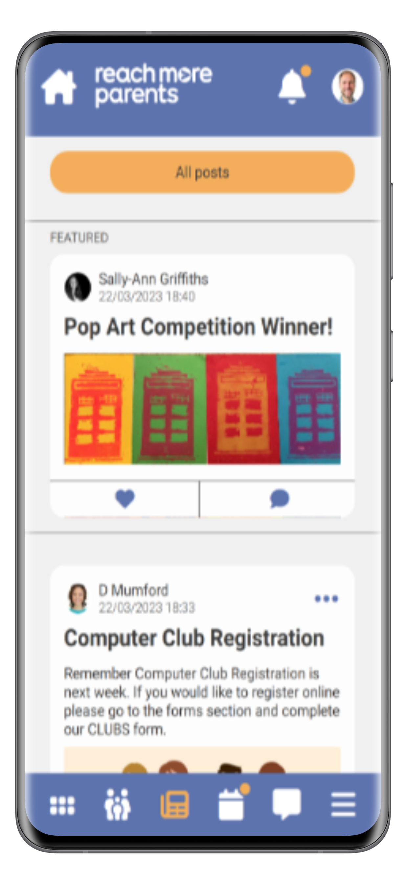
Features
Newsfeed
Our newsfeed layout helps users see the latest posts without missing existing pinned posts.
Pinned posts utilise less screen space and are grouped together as featured posts within a horizontally formatted section.
This means users don't need to scroll past historical posts to see new content, they can view important content without it being missed.

Slide 7
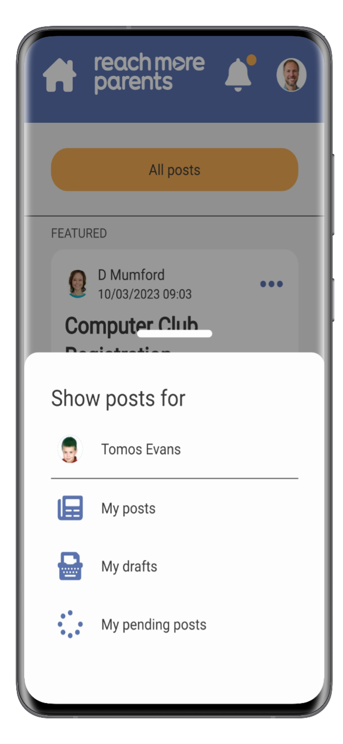
Features
Newsfeed
Parents who have more than one child at a school can filter their newsfeeds by child.

Slide 8
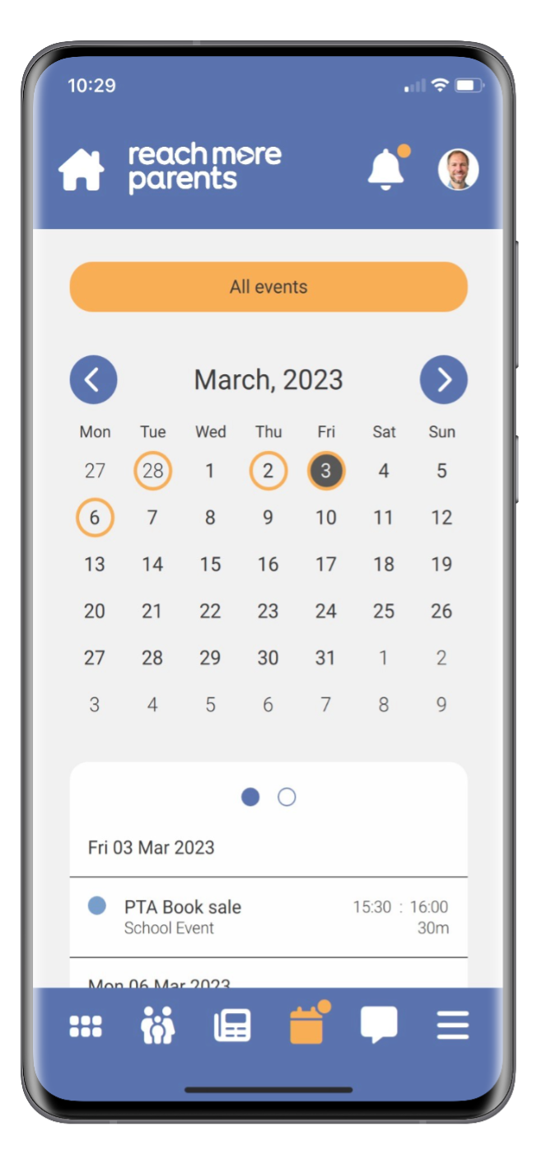
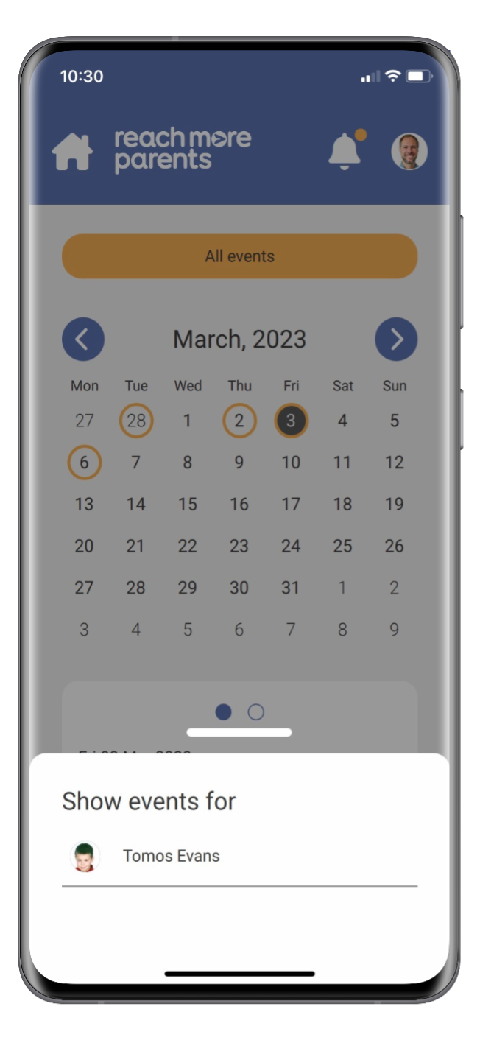
Features
Calendar
Like with the newsfeed filter, parents with children at more than one school can filter calendar events by individual child.

Slide 9
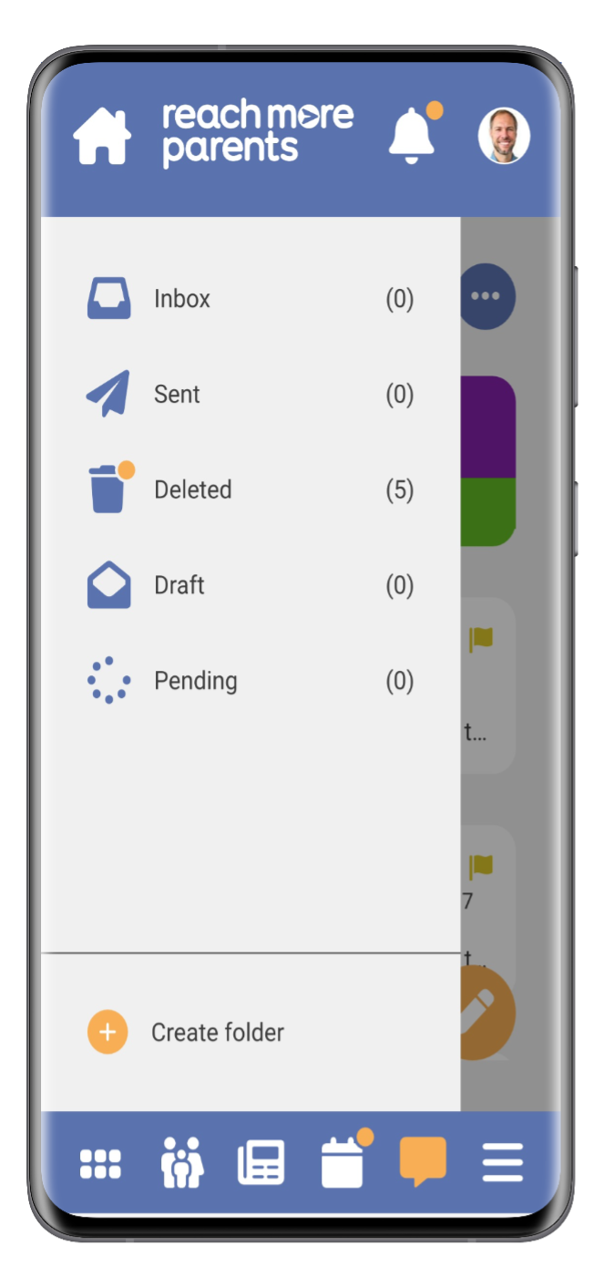
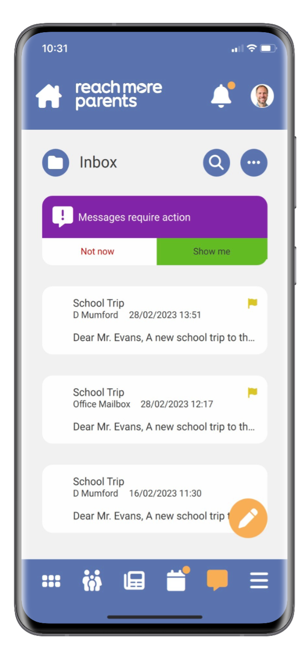
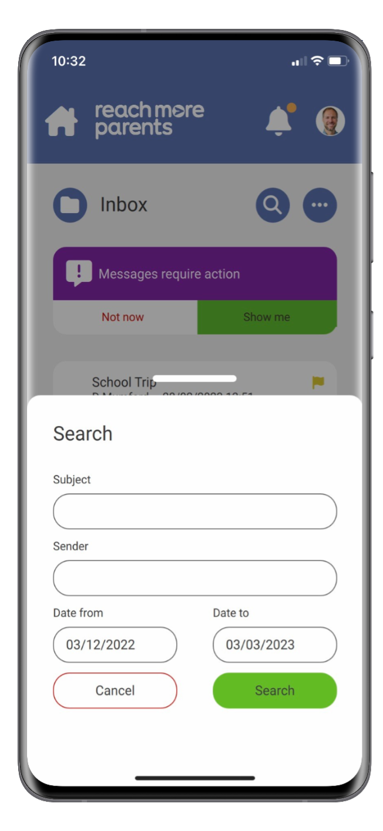
Features
Messages
Messages has a search facility, enabling parents to find key messages quickly.
They can also create additional folders to store messages in.

Slide 10
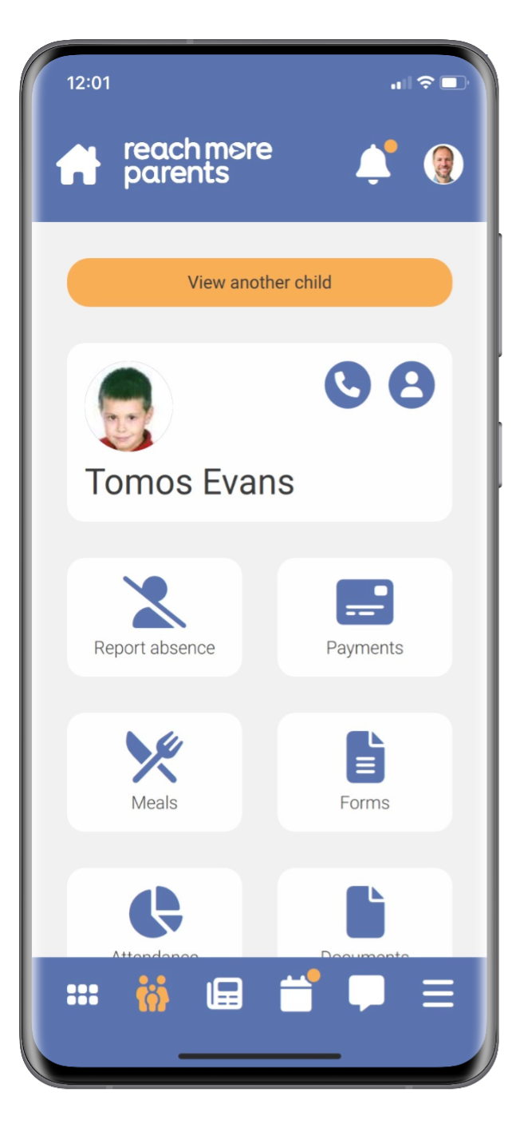
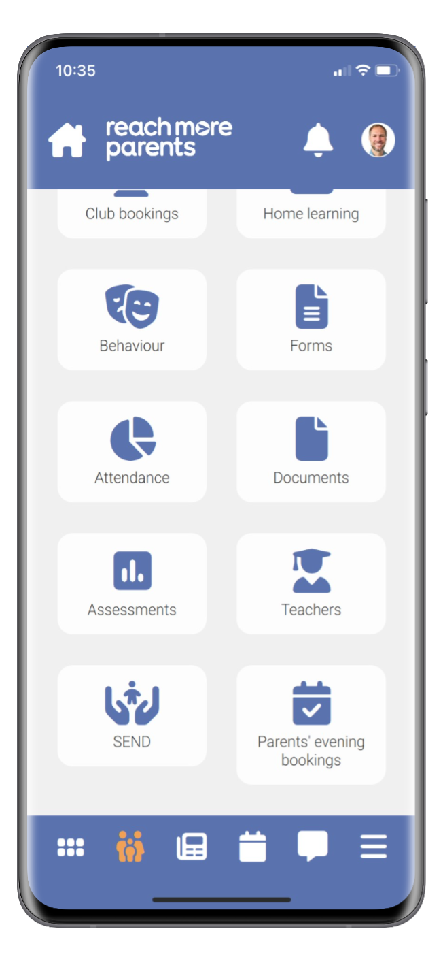
Features
Parent Portal
The Parent Portal enables parents to find child-specific items all in one place such as:
  Home learning tasks
  Payments*
  Forms
  *Only for customers who have sQuid Payments

Slide 11
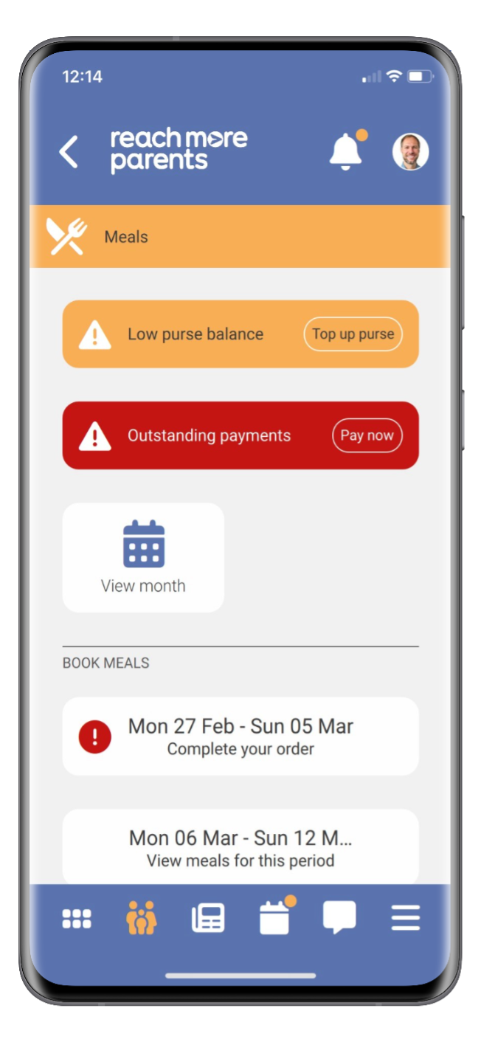
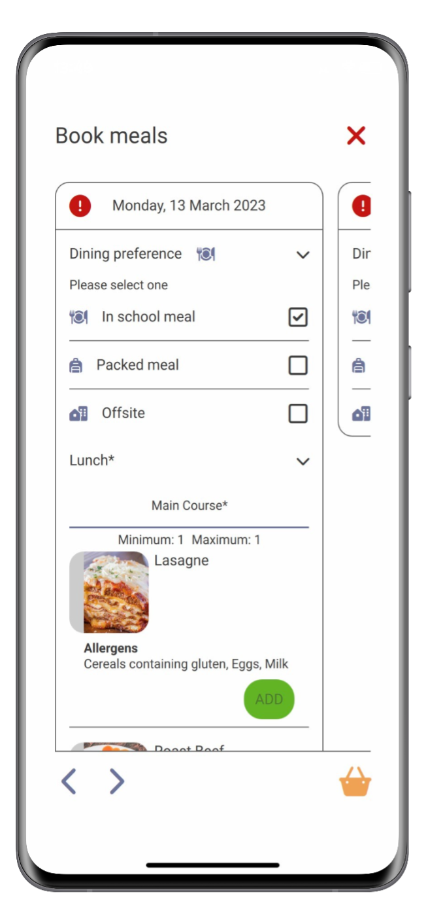
Features
Meal Manager*
The Meal Manager dashboard displays key information such as outstanding payments and low balances. There is also a booking wizard so parents can easily order meals in weekly batches.
*Only for customers who have Meal Manager

